Slide 1
Forecasting Supply Chain Demand signals using Artificial Intelligent Methods for the Shipping Industry
- Ammar Ameerdeen

Slide 2
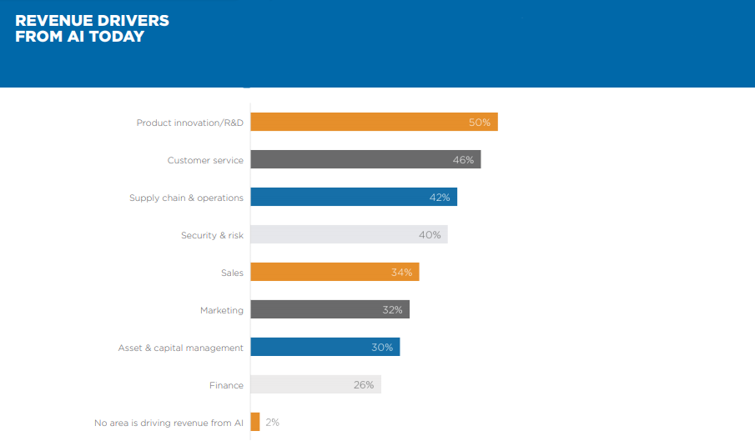

Slide 3
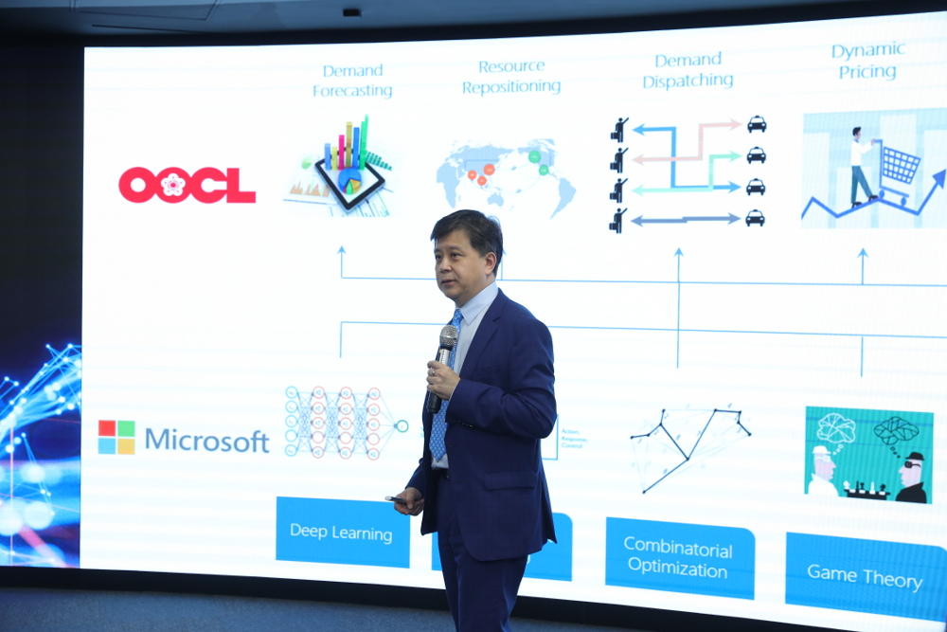

Slide 4
Ongoing innovations in the industry
DHL | Predictive network to identify top factors influencing shipment delays.
Panalpina | ClearMetal
EFL | For classification and augment decision making in the process phasing out manual processes.
OOCL | Partnership with Microsoft’s MSRA.
H&M | Sea Machines
Singapore Marine | Shipping broker system (Shipmax)

Slide 5
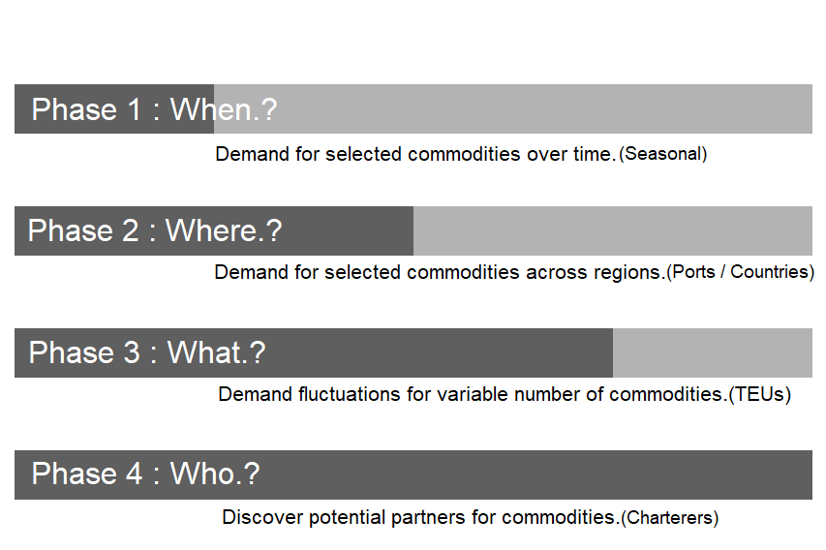
Project phases

Slide 6
Resources
Data for model designing, training and validation.
Kaggle
Data made available by government agencies. (Eg :- Statistics Canada)
Masked of trend data.
Web scraping data.
* Data will be handled with due attention to existing legal requirements as devised by DMCA and also abiding to BCS code of conduct as this research program is accredited by BCS.

Slide 7
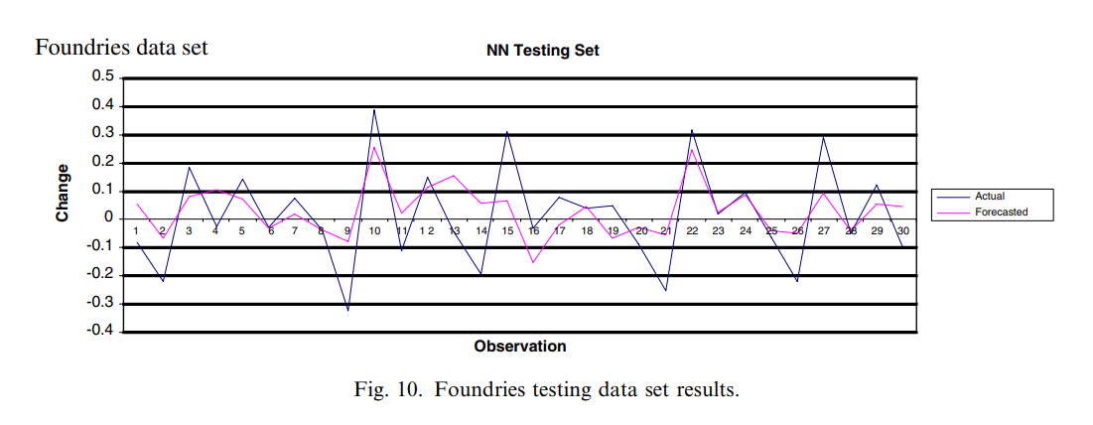
Past research demo (1)

Slide 8
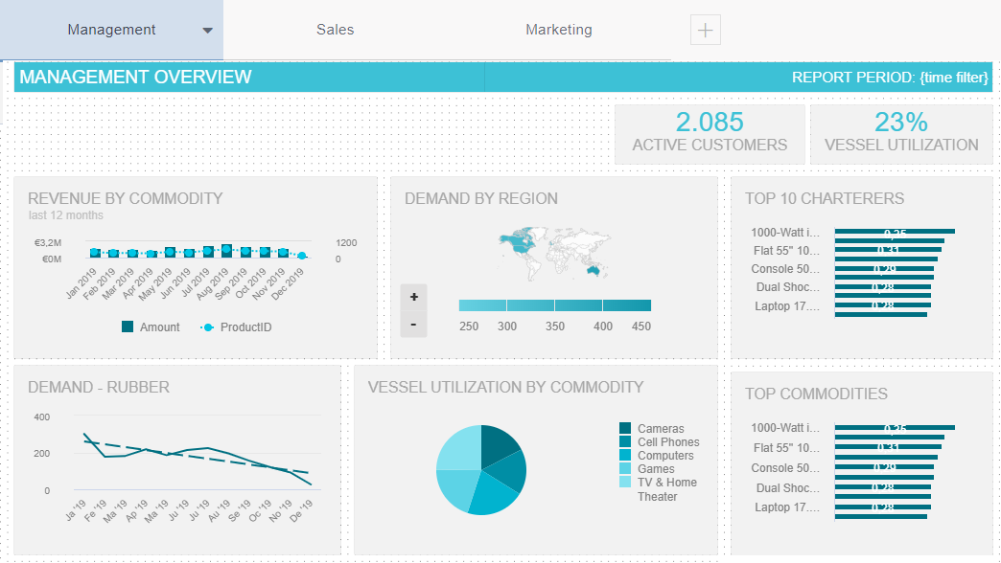

Slide 9
Important deadlines
Prototype | January 31st 2020
MVP (Minimum Viable Product) | April 30th 2020
Research Document | May 31st 2020

Slide 10
Thank you !

Slide 11
More technical information

Slide 12
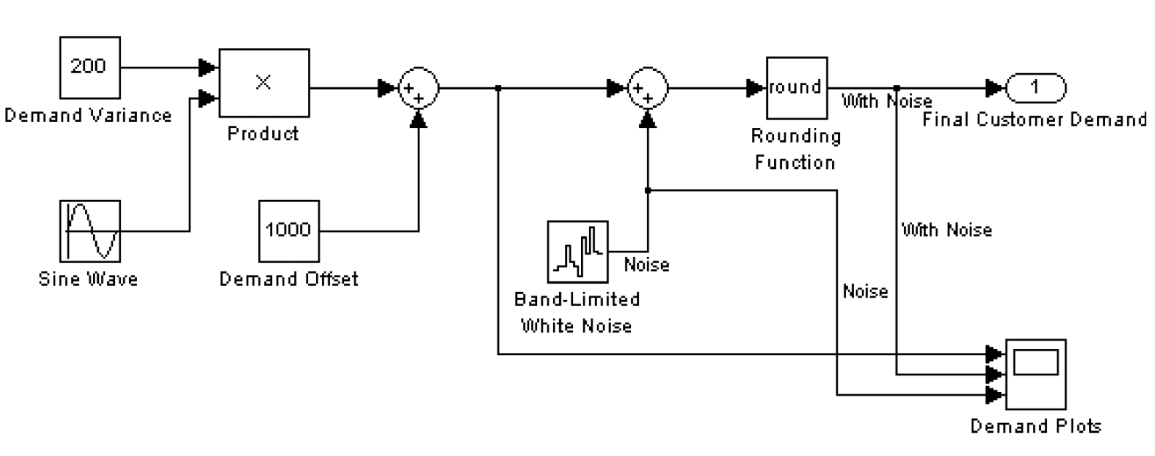
Simulation (End customer)

Slide 13
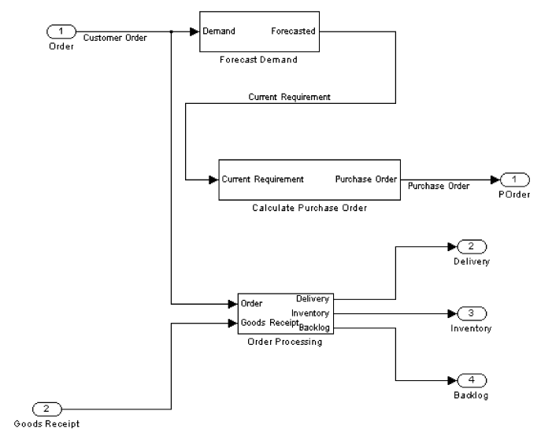
Simulation (Partner)

Slide 14
Modern Methodologies & Concepts
Methodologies.
Structural risk minimization models
Support Vector Machine
Empirical risk minimization models
Neural Networks
Recurrent Neural Networks
Logistic regression
Simulation
Traditional concepts
Naı¨ve forecasting
Moving average
Linear regression
Collaborative forecasting and replenishment (CFAR)

Slide 15
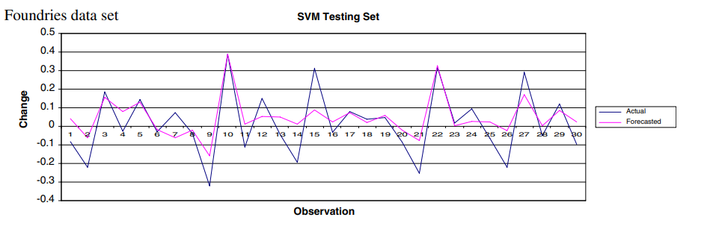
Past research demo (2)

Slide 16
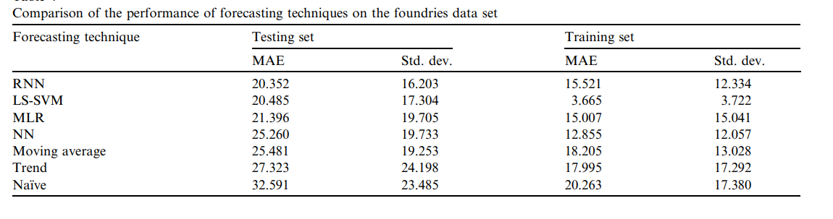
Past research comparison (3)

Slide 17
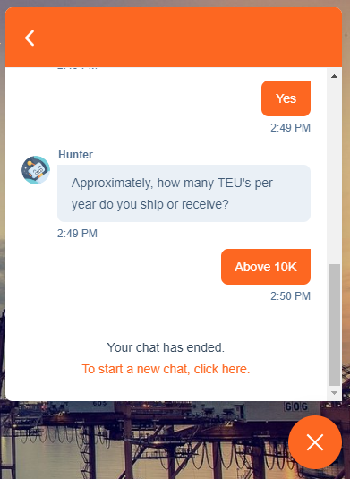
Possible future ideas

Slide 18
Thank you again!

